Slide 1

7th Grade Math
Unit 3, Lesson 4 Dividing Rational Numbers Volume 1, pg. 100

Slide 2


Benchmark
MA.7.NSO.2.2
Add, subtract, multiply, and divide rational numbers with procedural fluency.
volume 1, pg. 100

Slide 3
Integrated Mathematical Thinking and Reasoning Standards
MA.K12.MTR.1.1 Actively participate in effortful learning both individually and collectively.
MA.K12.MTR.2.1 Demonstrate understanding by representing problems in multiple ways.
MA.K12.MTR.3.1 Complete tasks with mathematical fluency.
MA.K12.MTR.4.1 Engage in discussions that reflect on the mathematical thinking of self and others.
MA.K12.MTR.5.1 Use patterns and structure to help understand and connect mathematical concepts.
volume 1, pg. 100

Slide 4

Learning Target
I can fluently divide rational numbers.
volume 1, pg. 100

Slide 5

Warm-Up
volume 1, pg. 100

Slide 6
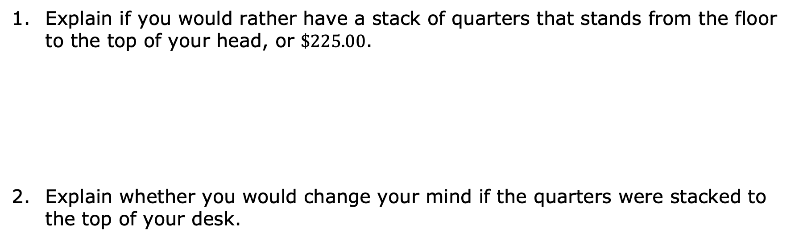
3.4.1 Warm-Up: Would You Rather?
Explain if you would rather have a stack of quarters that stands from the floor to the top of your head, or $\$225.00$.
Explain whether you would change your mind if the quarters were stacked to the top of your desk.
volume 1, pg. 100
Notes:
Video Link: https://algebranation.wistia.com/medias/fi4fidi5y8

Slide 7

Refresher
volume 1, pg. 101

Slide 8

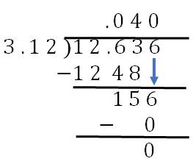
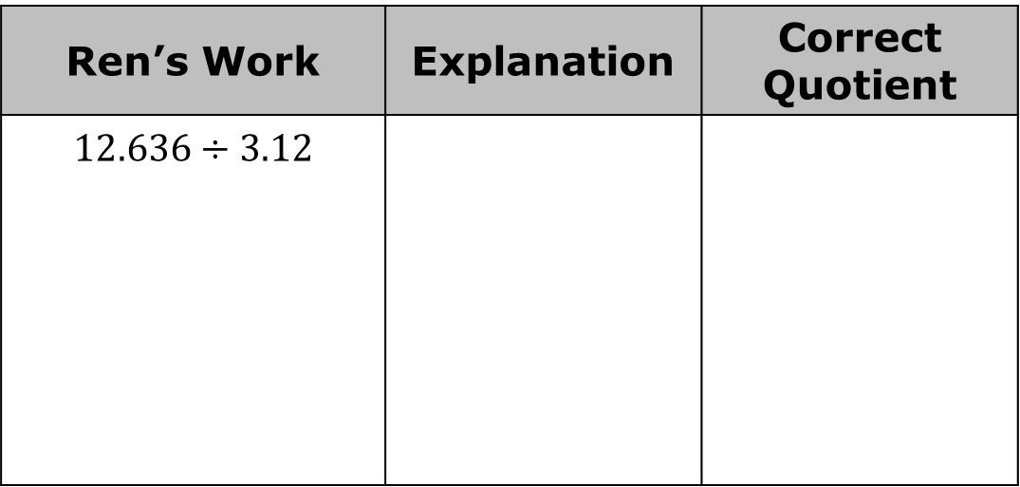
3.4.2 Refresher: Dividing Positive Rational Numbers
Ren found the following quotient, making at least one error in her work.
Circle the error(s) in Ren’s work and write an explanation of the error(s). Then, find the correct quotient.
Ren’s Work | Explanation | Correct Quotient
$$12.636÷3.12$$
volume 1, pg. 101

Slide 9
What advice do you have for Ren that could help her with dividing decimals in the future?
volume 1, pg. 101

Slide 10
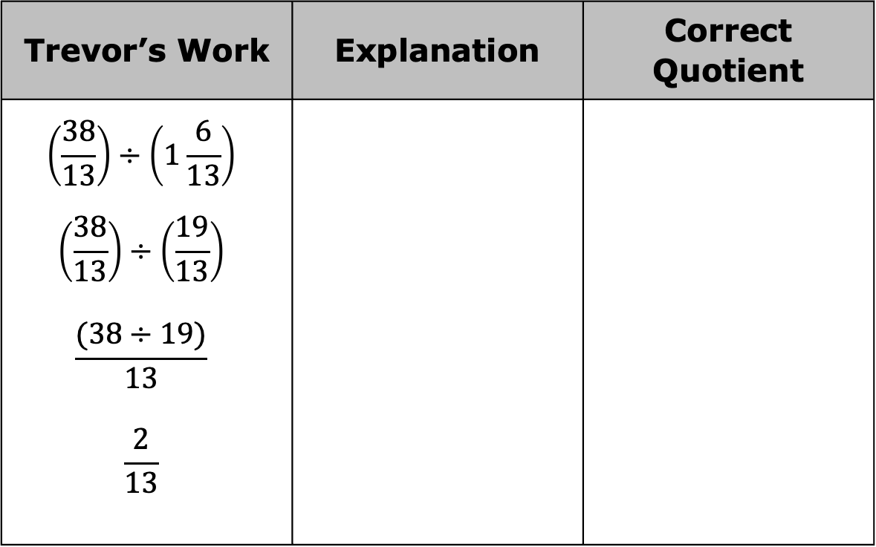
Trevor found the following quotient, making at least one error in his work. Circle the error(s) in Trevor’s work. Write an explanation of the error(s). Then, find the correct quotient.
Trevor’s Work | Explanation | Correct Quotient
$$\left(\frac{38}{13}\right)÷\left(1\frac{6}{13}\right)$$ $$\left(\frac{38}{13}\right)÷\left(\frac{19}{13}\right)$$ $$\frac{(38÷19)}{13}$$ $$\frac{2}{13}$$
volume 1, pg. 101

Slide 11

Collaboration
volume 1, pg. 102

Slide 12

3.4.3 Collaboration: Signed Number Rules
Fill in the blanks with the words positive or negative to write the rules for dividing integers.
The quotient of two positive integers is a ________ integer.
The quotient of two negative integers is a ________ integer.
The quotient of a negative integer divided by a positive integer is a ________ integer.
The quotient of a positive integer divided by a negative integer is a ________ integer.
volume 1, pg. 102

Slide 13
Discuss with your partner whether you think the same rules apply to rational numbers. Write a summary of your reasoning.
volume 1, pg. 102

Slide 14
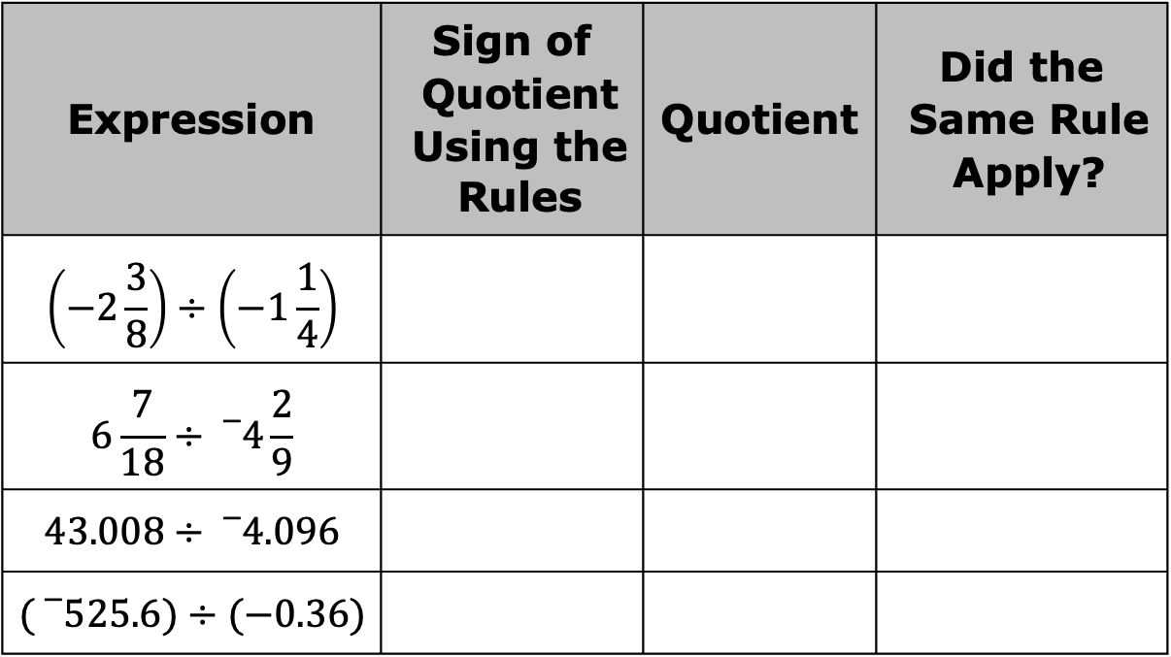
Complete the table. Use a calculator to find the quotient of each expression to verify if the same rules for signs apply when dividing rational numbers.
Expression | Sign of Quotient Using the Rules | Quotient | Did the Same Rule Apply?
$$\left(−2\frac{3}{8}\right)÷\left(−1\frac{1}{4}\right)$$
$$6\frac{7}{18}÷{}_{}^{−}{4\frac{2}{9}}$$
$$43.008÷{}_{}^{−}{4.096}$$
$$({}_{}^{−}{525.6)}÷(−0.36)$$
volume 1, pg. 102

Slide 15
Complete the sentence.
The rules for dividing rational numbers are the integer rules for division.
the same as
different from
volume 1, pg. 102

Slide 16

Guided Practice
volume 1, pg. 103

Slide 17

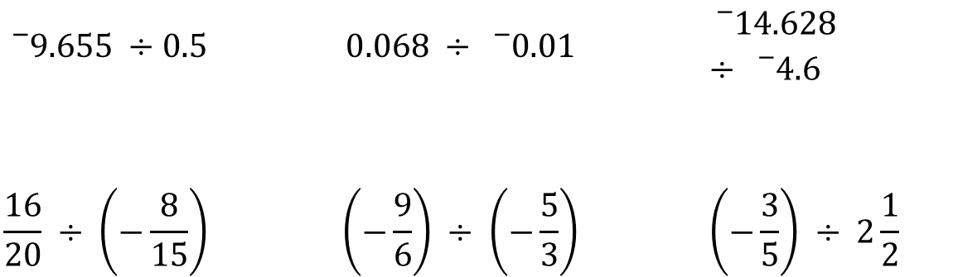
3.4.4 Guided Practice: Finding Quotients of Rational Numbers
Circle the expressions that will result in a positive quotient.
$${}_{}^{−}{9.655 ÷0.5}$$ | $$0.068 ÷ {}_{}^{−}{0.01}$$ | $${}_{}^{−}{14.628} ÷ {}_{}^{−}{4.6}$$
$$\frac{16}{20} ÷ \left(−\frac{8}{15}\right)$$ | $$\left(−\frac{9}{6}\right) ÷ \left(−\frac{5}{3}\right)$$ | $$\left(−\frac{3}{5}\right) ÷ 2\frac{1}{2}$$
volume 1, pg. 103

Slide 18
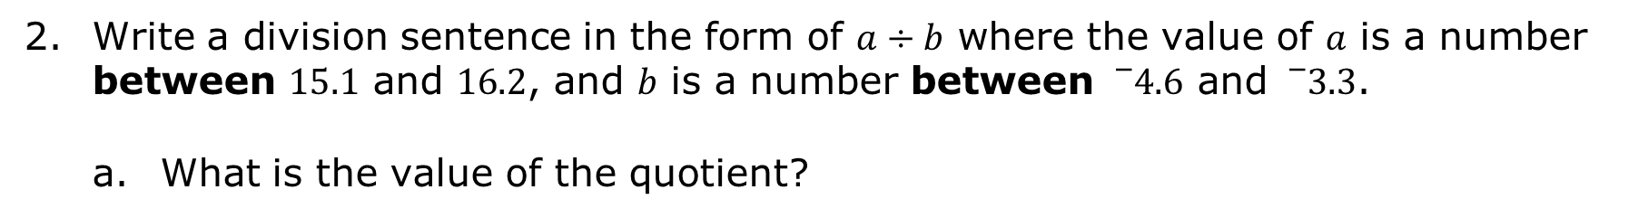
Write a division sentence in the form of $a÷b$ where the value of 𝑎 is a number between $15.1$ and $16.2$, and 𝑏 is a number between ${}_{}^{−}{4.6}$ and ${}_{}^{−}{3.3}$.
What is the value of the quotient?
volume 1, pg. 103

Slide 19

Your Turn
volume 1, pg. 103

Slide 20
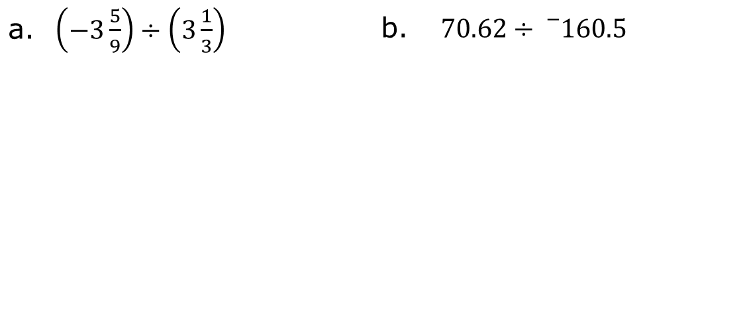
3.4.5 Your Turn!
Find the value of each expression.
$\left(−3\frac{5}{9}\right)÷\left(3\frac{1}{3}\right)$ | $70.62÷{}_{}^{−}{160.5}$
volume 1, pg. 103

Slide 21
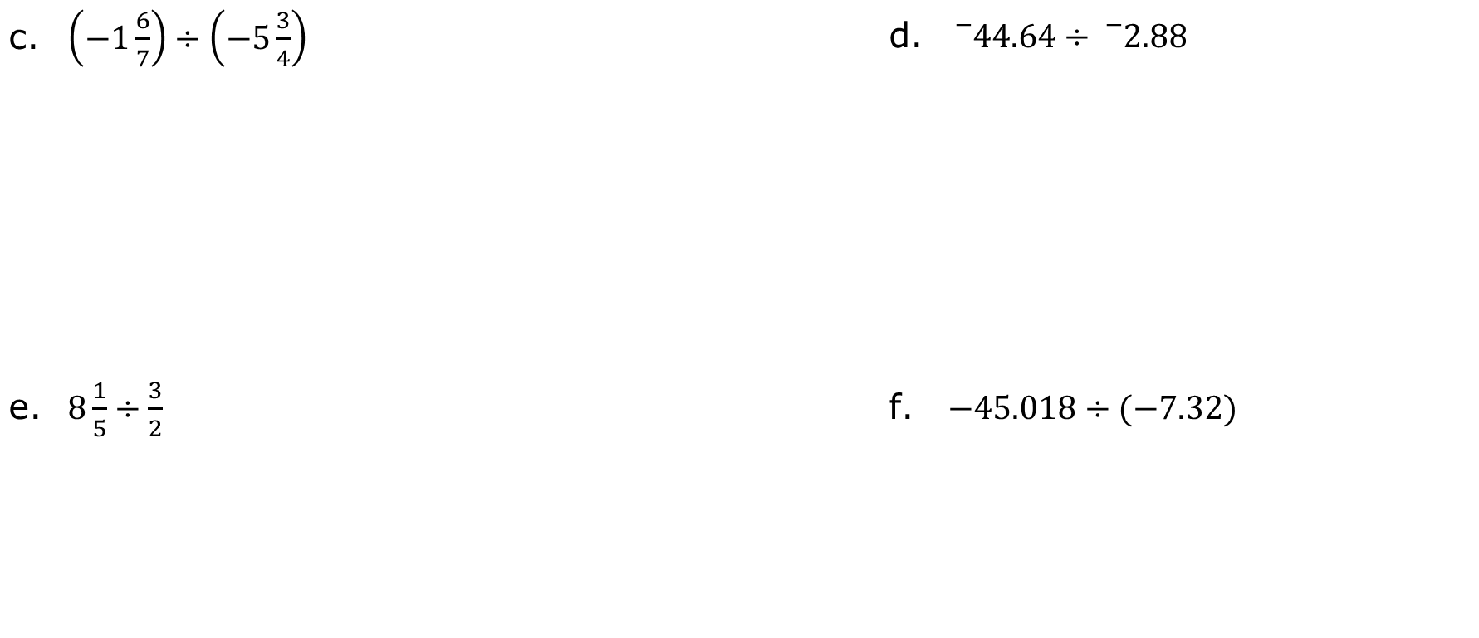
$\left(−1\frac{6}{7}\right)÷\left(−5\frac{3}{4}\right)$ | ${}_{}^{−}{44.64}÷{}_{}^{−}{2.88}$
$8\frac{1}{5}÷\frac{3}{2}$ | $−45.018÷(−7.32)$
volume 1, pg. 103

Slide 22

Wrap-Up
volume 1, pg. 104

Slide 23
3.4.6 Wrap-Up: Reflection
Draw an X on each line to indicate where your current learning is in relation to each statement. Then, provide a brief explanation or evidence to support your self-assessment.
I can correctly decide the sign of the quotient when dividing rational numbers.
Evidence:
I need help. I can’t get started. | I’m getting there. | I understand and have evidence.
volume 1, pg. 104

Slide 24
I can fluently divide rational numbers that are fractions.
Evidence:
I can fluently divide rational numbers that are decimals.
Evidence:
I need help. I can’t get started. | I’m getting there. | I understand and have evidence.
I need help. I can’t get started. | I’m getting there. | I understand and have evidence.
volume 1, pg. 104

